Slide 1
Interactive computation and visualization of wind farm flow fields based on model reduction
Yngve Heggelund
CMR Computing

Slide 2
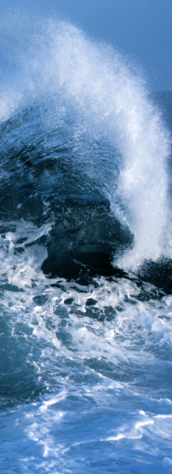
Norwegian Centre for Offshore Wind Energy - NORCOWE
Center for environment-friendly energy research (CEER)
50% RCN, the rest from industry and research partners
Combining Norwegian offshore technology and Danish wind energy competence
Research partners:
Christian Michelsen Research AS (host)
UiS
UiA
UiB
Aalborg University
Uni Research AS

Slide 3
NORCOWE WP 4 – Wind farm optimization
Vision: Model system for optimizing the layout of (offshore) wind farms based on Computational Fluid Dynamics (CFD)
Nowcasting: 2-120 seconds
Power system integration
Wind farm modelling

Slide 4
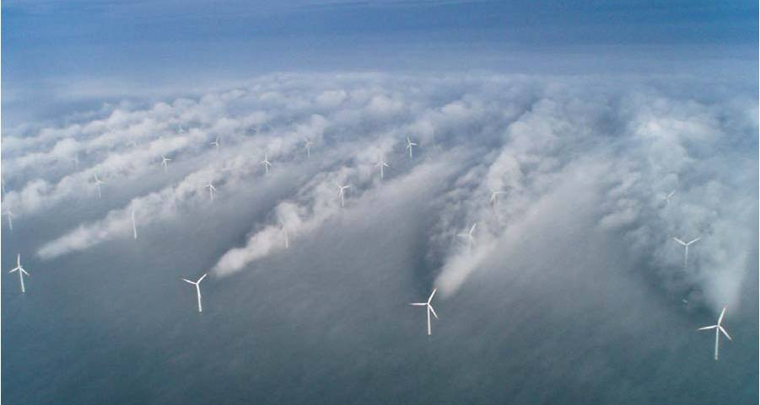
Wakes
Wake effects caused by upstream turbines
Reduces energy output of downstream turbines
Increases material fatigue because of increased turbulence

Slide 5
Objectives
Find a layout which minimizes the wake effects
Reduce the uncertainty of production estimates

Slide 6
Motivation
Traditional approach: simplified wake models
Often underestimates wake effects
CFD provides the state-of-the-art method for solving complex flow problems
CFD is computationally expensive – one simulation typically takes hours/days/weeks to complete
Prohibits straightforward use in optimization of layout
We have to make some simplifications!

Slide 7
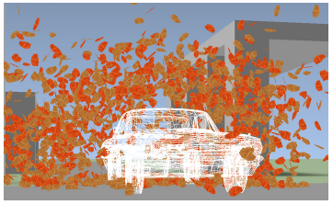
Model reduction, background
Idea: Restrict the solution space to a reduced representative subspace
Full dimension ~3 000 000 grid cells
Subspace dimension ~100 unknowns
E.g. used for real-time visualization of fluid effects (Treuille et al. 2006)
Examples of other applications of model reduction for fluids
Study of flow past a rectangular cavity (Rowley, 2002)
Optimal rotary control of cylinder wake (Bergman et al., 2005)

Slide 8
Model reduction, theoretical framework
Steady state RANS (Reynolds-Averaged Navier-Stokes) momentum equations
$$ρ\frac{∂}{∂x_{j}}\left(u_{i}u_{j}\right)=−\frac{∂p}{∂x_{i}}+\frac{∂}{∂x_{i}}\left(τ_{ij}\right)+ρa_{i}$$
$\overline{u}={\left[u_{1},⋯, u_{n/4},v_{1},⋯,v_{n/4},w_{1},⋯, w_{n/4},p_{1},⋯,p_{n/4} \right]}^{T}$
Seek solutions in a space spanned by an orthonormal basis (m $≪$ n)
$$B=\left[φ_{1}, φ_{2, ⋯, }φ_{m}\right], \left\langle φ_{i},φ_{j}\right\rangle =\left\{\begin{aligned}1 i=j \\ 0 i ≠j \end{aligned}\right.$$
Any solution in the reduced space is a linear combination of the basis vectors
$$ψ=B\overline{a}$$
Constraint: Solutions should fulfil the force balance in the steady state RANS equations

Slide 9
Model reduction, operator examples
CFD discretization
Reduced order space representation
Pressure operator
$$\frac{∂p}{∂x_{i}}≈P\overline{u}≈PB\overline{a}$$
Projected to reduced space:
$$B^{T}PB\overline{a}$$
$$m×n n×n n×m$$
Advection operator is nonlinear
Implies one operator matrix for each basis vector
Can show that this can be expressed by a tensor of third order:
$$T_{ijk}a_{k}a_{j}$$
In this way the governing equations can be expressed in the reduced space
$$m×m×m$$

Slide 10
Contructing a representative basis
Snapshots of CFD solutions for different placements of turbines
Singular value decomposition (SVD) to extract an orthonormal basis which minimizes the reconstruction error
A representative basis is critical for a good result!

Slide 11
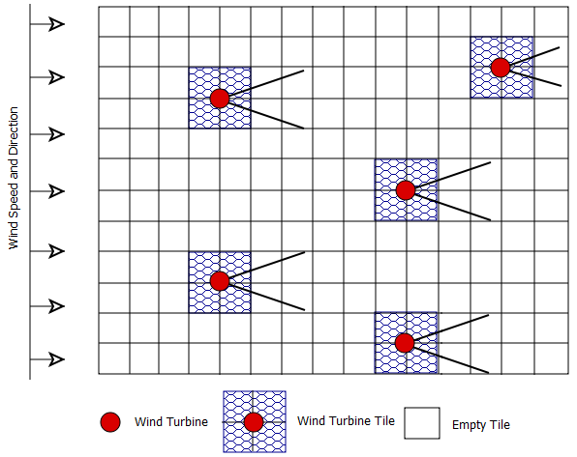
Tiles
Must be able to move turbines
Construct tiles which capture localized behaviour, which can be assembled at runtime
Couple tiles through matching the boundary conditions
Results in a system of equations represented by a large sparse block matrix
Solving for the coefficients in each tile
Trade-off between matching boundary conditions and fulfilling the steady state RANS equations

Slide 12
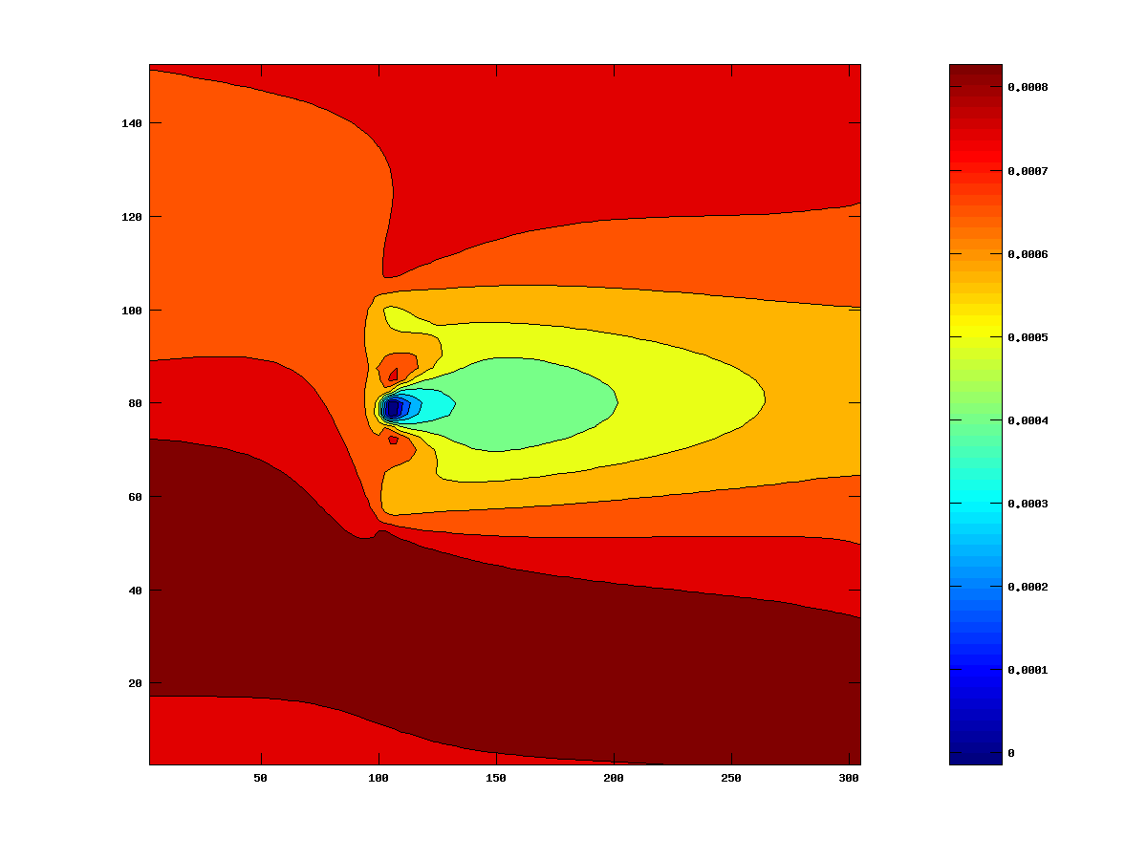
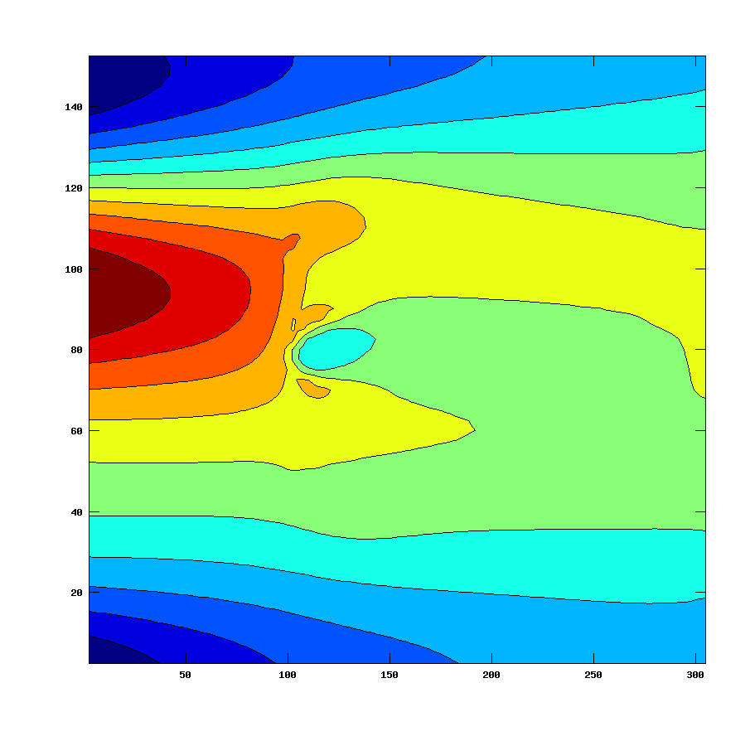
Test case
Idealized system with three wind turbines and wind predominantly from the west
Where should turbine C be placed?
6 simulations with FLACS-Wind (CMR GexCon) for different positions of the back row turbine
A
C
B
The two most important modes in the basis

Slide 13
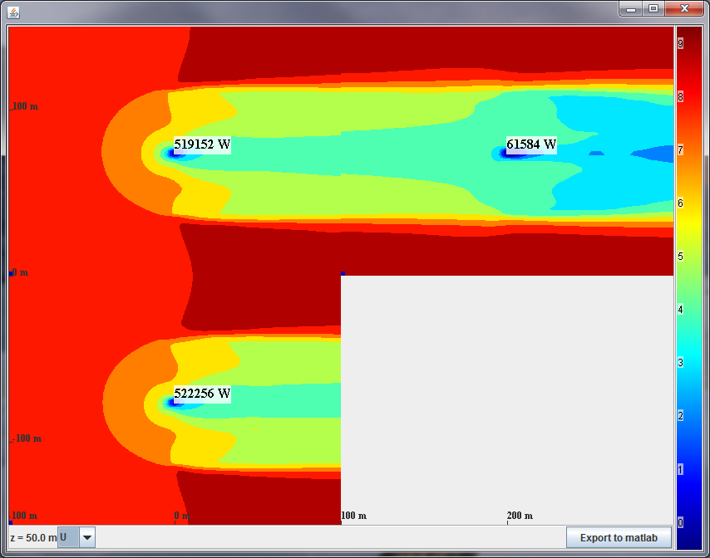
Interactive tool for testing turbine positions
User can move turbines by dragging tiles
New flow fields and production estimates are calculated within seconds

Slide 14
Demo

