Slide 1
Medical Visualization of Human Physiology Data: an Overview
Paolo Angelelli

Slide 2
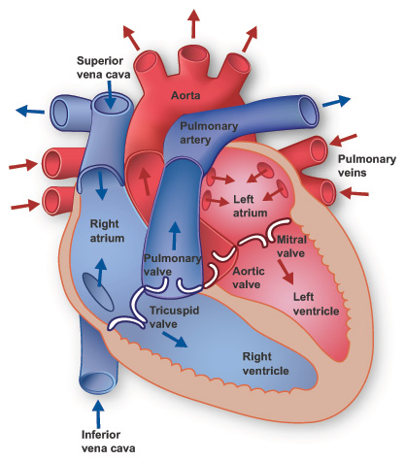
Human Physiology
Definitions:
“The science of the mechanical, physical, and biochemical functions of humans, their organs, and the cells of which they are composed”
“The study of specific characteristics and mechanisms of the human body that make it a living being”
“The study of life processes”
Let’s compare it to Anatomy:
“The consideration of the shape and structure of living things.”
Why Important? Physiological processes make us stay alive!

Slide 3
Guyton textbook of Medical Physiology UNITS
Cell physiology
Membrane, Nerve and Muscle physiology
Metabolism and temperature regulation
Heart physiology
The circulation
The body fluids and kidneys
Blood Cells, Immunity, and Blood Clotting
Respiration
Aviation, Space and Deep-Sea-Diving physiology
The Nervous System and Sensory physiology
The Nervous System: The special senses
Motor and Integrative neurophysiology
Gastrointestinal physiology
Endocrinology and Reproduction
Sport physiology
Micro Level
24 pages index
Macro Level

Slide 4
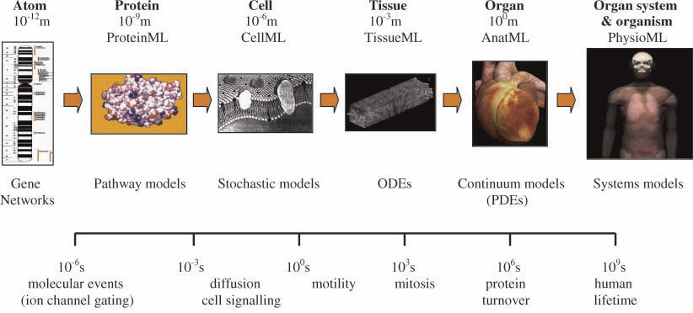
Imaging and modeling physiology
www.physiome.org
Medical Imaging techinques (time resolved) for capturing physiological processes at various time scales
Understanding of the process
Diagnosis of diseases
Physiome projects: modeling the physiological processes in the human.
Derivation of parameters not directly obtainable from image data
Prediction of individual response to treatment (treatment optimization , cost and time saving)
Decrease of failure rate in drug development by predicting the effects at sub-cellular, cellular, tissue, organ, whole body level
Identification of the most sensible target
Understanding of the mechanism of complex diseases
Identify patient-specific prevention measures
Hunter et al.., 2002
Notes:
Stress that I will talk about micro Modeling and Macro Imaging

Slide 5
Data sources
Micro Level
Macro Level
CELLULAR PHYSIOLOGY | NERVE, MUSCLE, MEMBRANE | METABOLISM | HEART PHYSIOLOGY | CIRCULATION
Microscopy | Microscopy | Microscopy, PET, SPECT | Ultrasound, CT, MR, ECG, PET, SPECT | Ultrasound, MR, CFD
MICRO CIRCULATION | BODY FLUIDS and KIDNEYS | BLOOD CELLS and IMMUNITY | RESPIRATION | GASTRO-INTESTINAL
Ultrasound, MR, CT | MR, Microscopy | ? | CT, MR, US! | US, MR, CT
THE BRAIN | ENDOCRINOLOGY & REPRODUCTION | SPORT PHYSIOLOGY | AVIATION, SPACE, DEEP-SEA PHYS. | KINEMATIC (?)
fMR, EEG (PET/SPECT) | ? | ECG, GPS, WattMeters, other sensors | ? | Tracking Sensors

Slide 6
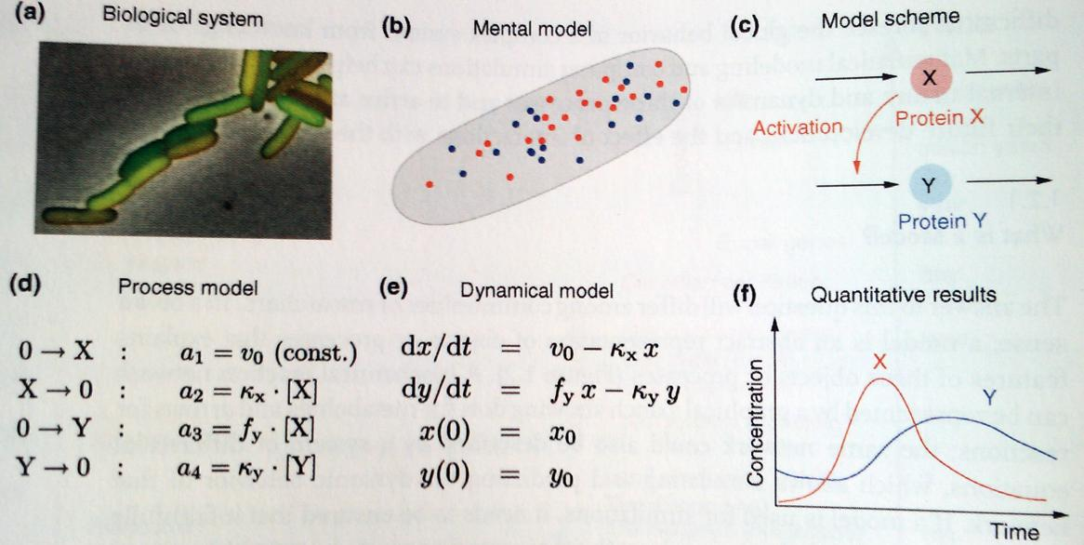
Extracting physiological models
Classic method: imaging -> visualization -> mental model -> model formalization -> process model definition -> quantitative results
Image courtesy of Edda Klipp

Slide 7
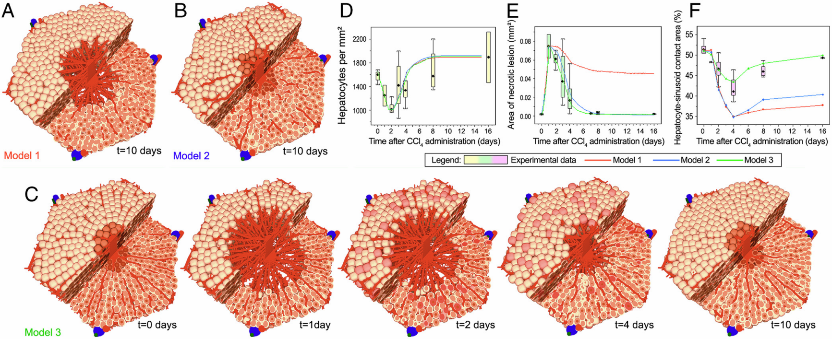
Extracting physiological models
Agent-Based models:
Related to discrete event simulation
Modeling constituent components (rule-based agents),
Dynamically simulating their interaction
Hepatocyte regeneration, Hoeme et al., 2010

Slide 8
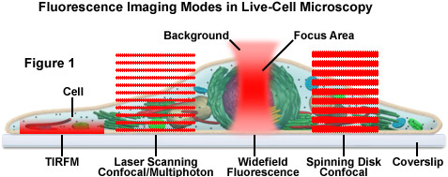
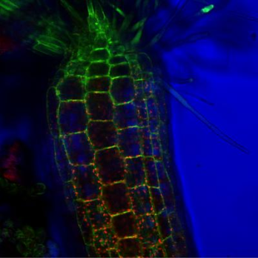
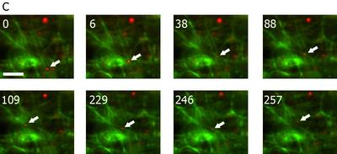
Micro Level physiology: Data Acquisition
Live Cell imaging techniques: traditionally time-lapse investigations monitoring cellular motility and dynamic events using contrast enhancement
Data: 2D/3D multivariate and time dependent cartesian grids
Protein-protein interaction (w. FRET, BRET)
Protein and vesicle trafficking (w. FRAP)
Processes close to cell membrane (w. TIRF)
Gene expression and protein transport (w. Photoactivation)
3D processes imaging (w. MPE)
cellular dynamics at nanometer scale (w. STED)
Spatial measurement in living cells (w. FILM)
http://www.leica-microsystems.com/science-lab/live-cell-imaging-techniques-visualizing-the-molecular-dynamics-of-life/
http://zeiss-campus.magnet.fsu.edu/articles/livecellimaging/techniques.html
Confocal live-cell image; GFP labeled in green, autofluorescent chloroplasts in red
Time sequence of TIRF; A Galectin-3 vesicle (marked with YFP)
close to the membrane (arrow) is first transported along an actin
filament (from the bottom upwards), switches to another filament
(88 s), moves to the left (109 s), is transported to the right again,
switches filament again and is then transported upwards (246 s).

Slide 9
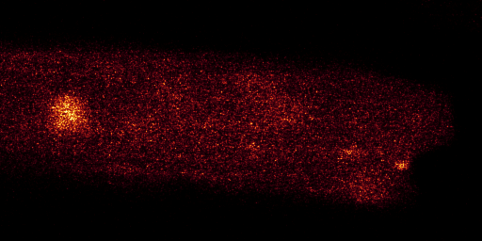
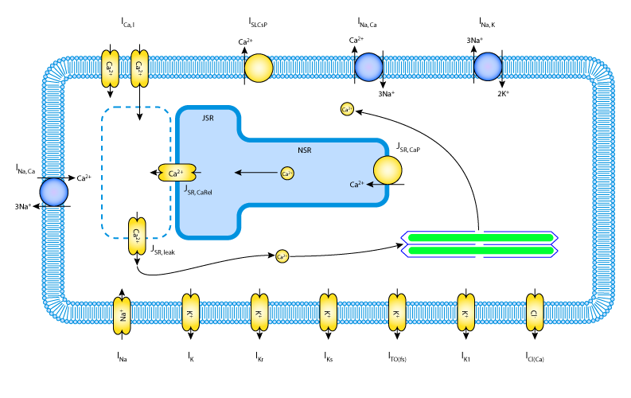
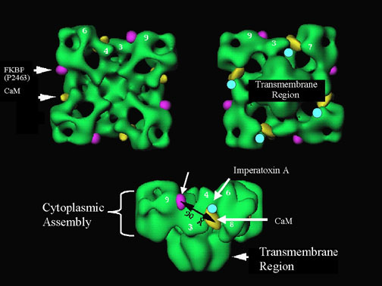
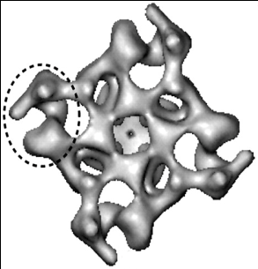
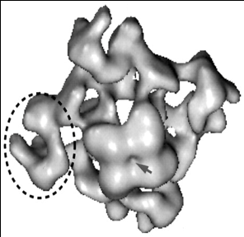
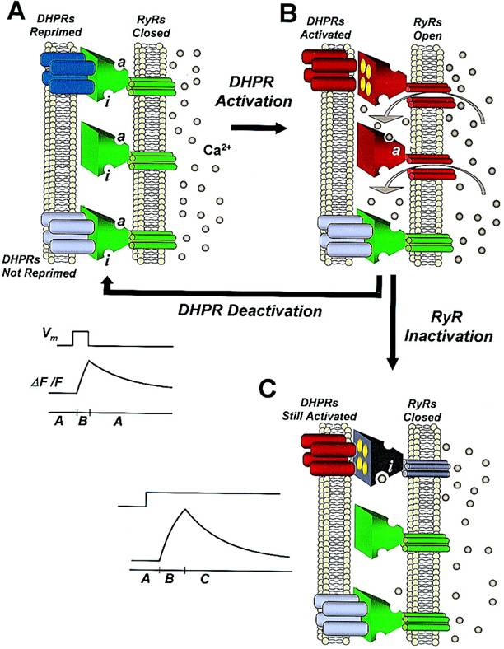
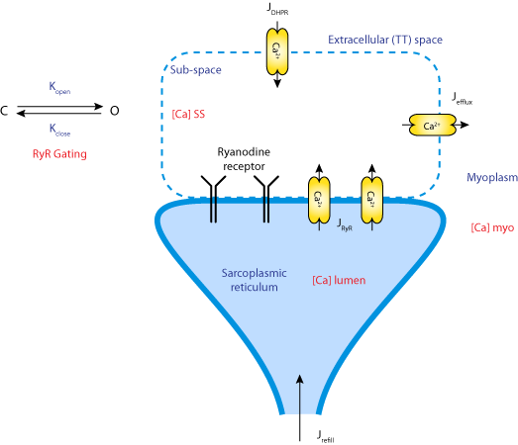
Cellular physiology: visualization and model extraction
Quantitative Cell Model Estimation
Structural Protein Models
Image courtesy of Confolab
cytosol
lumen
?
Serysheva et al., Biophys. J., 1999

Slide 10
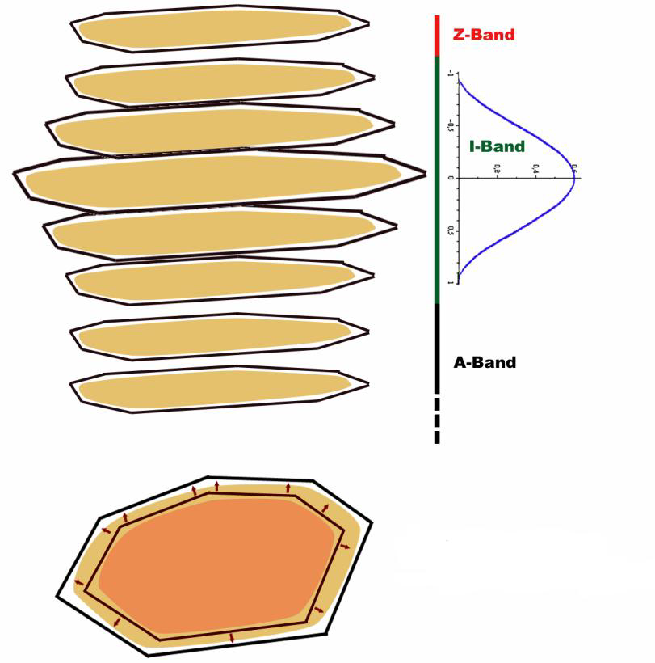
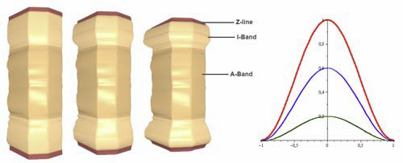
Muscle cells
Parulek and Remis 2009

Slide 11
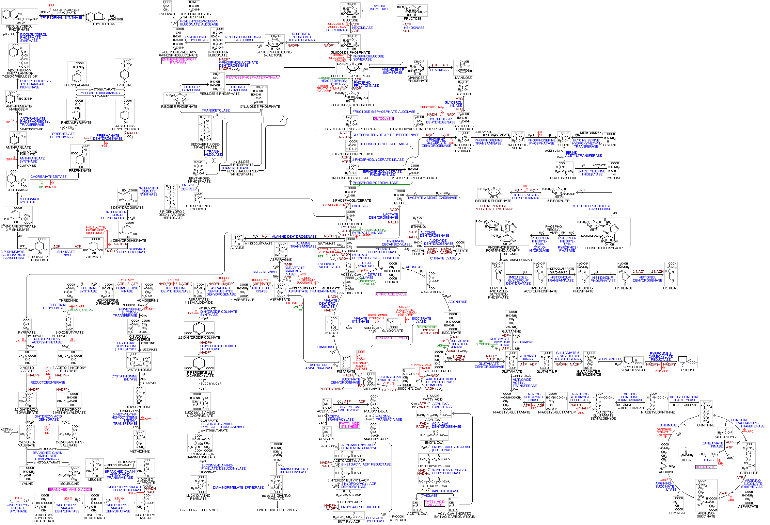
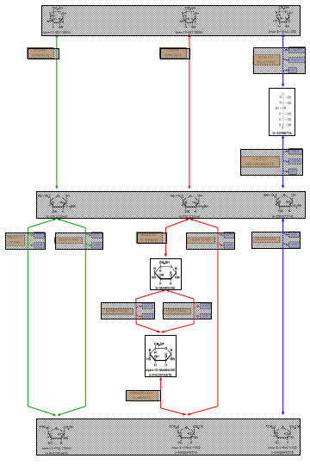
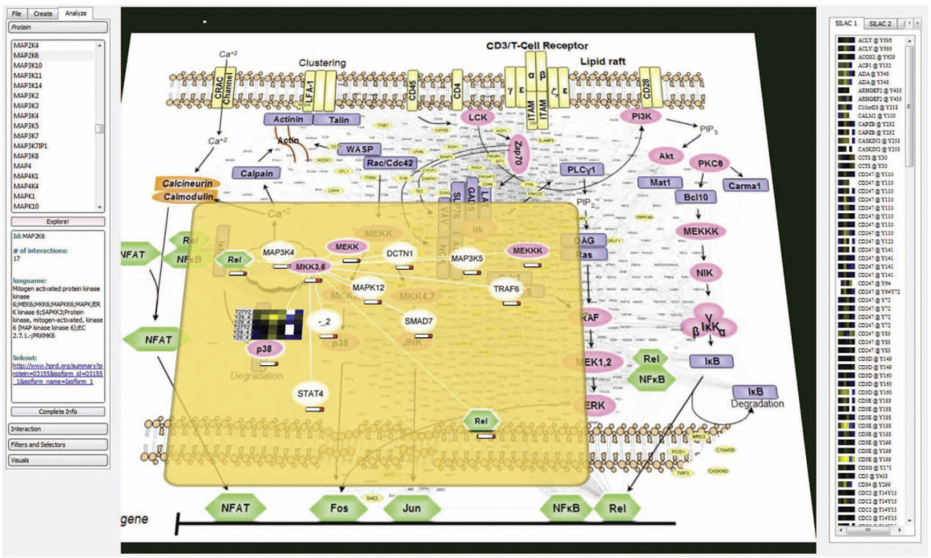
Metabolism
Visualization of the metabolic network (pathways)
Jianu 2010
Screiber 2006

Slide 12
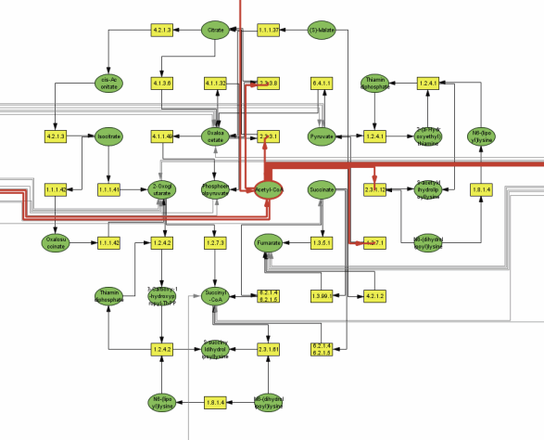
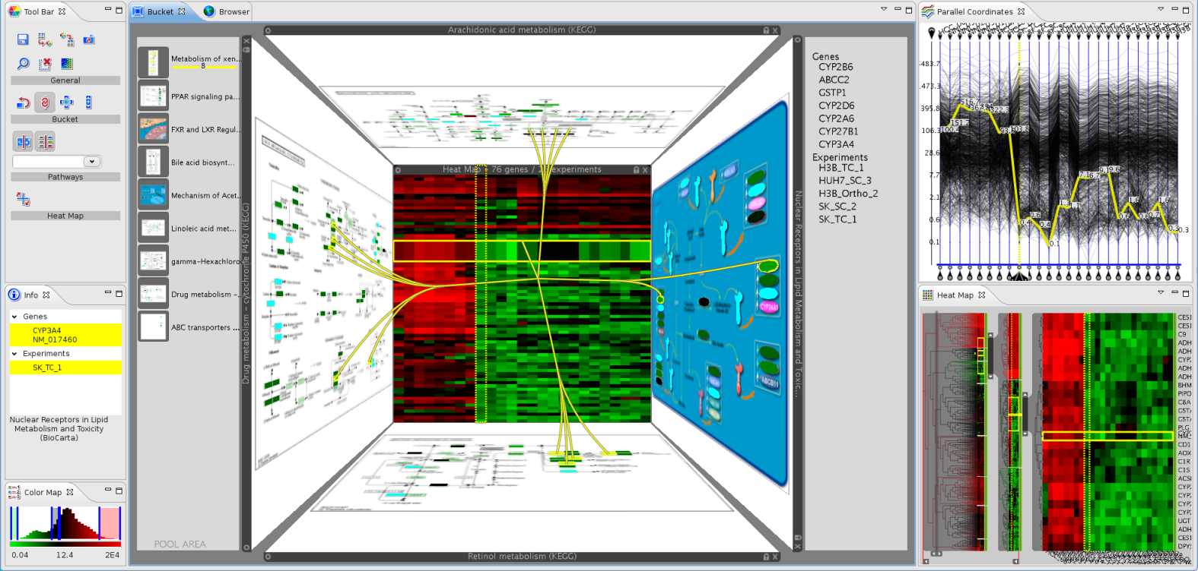
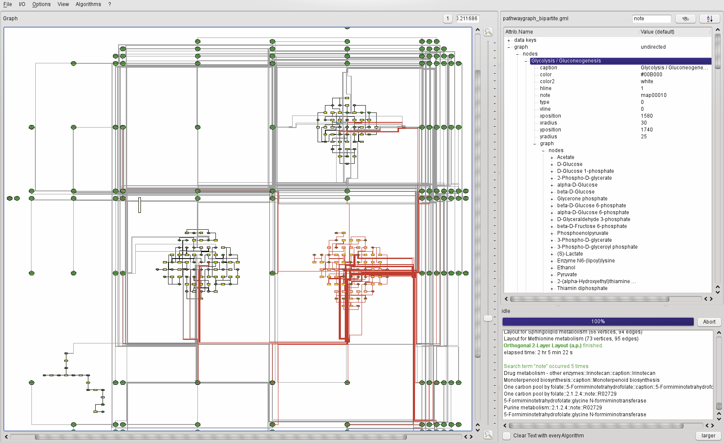
Metabolism 2
Visualization of the metabolic network (pathways)
Lex et al., 2010
Rohrschneider et al., 2009
Notes:
Caleydo: linking pathways and contained gene expression, as well as related pathways (which are not kept in one single network but subdivided into multiple network in the db due to the complexity)
Other: grid based approach for metabolic networks focus + c

Slide 13
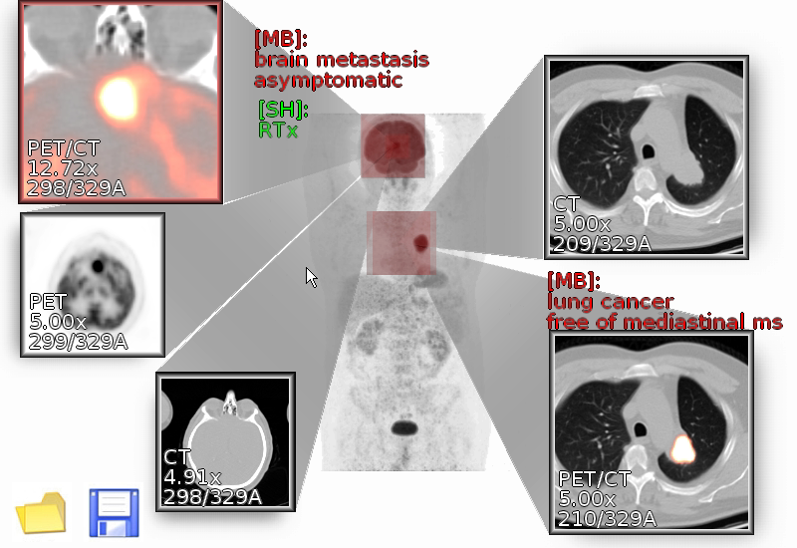
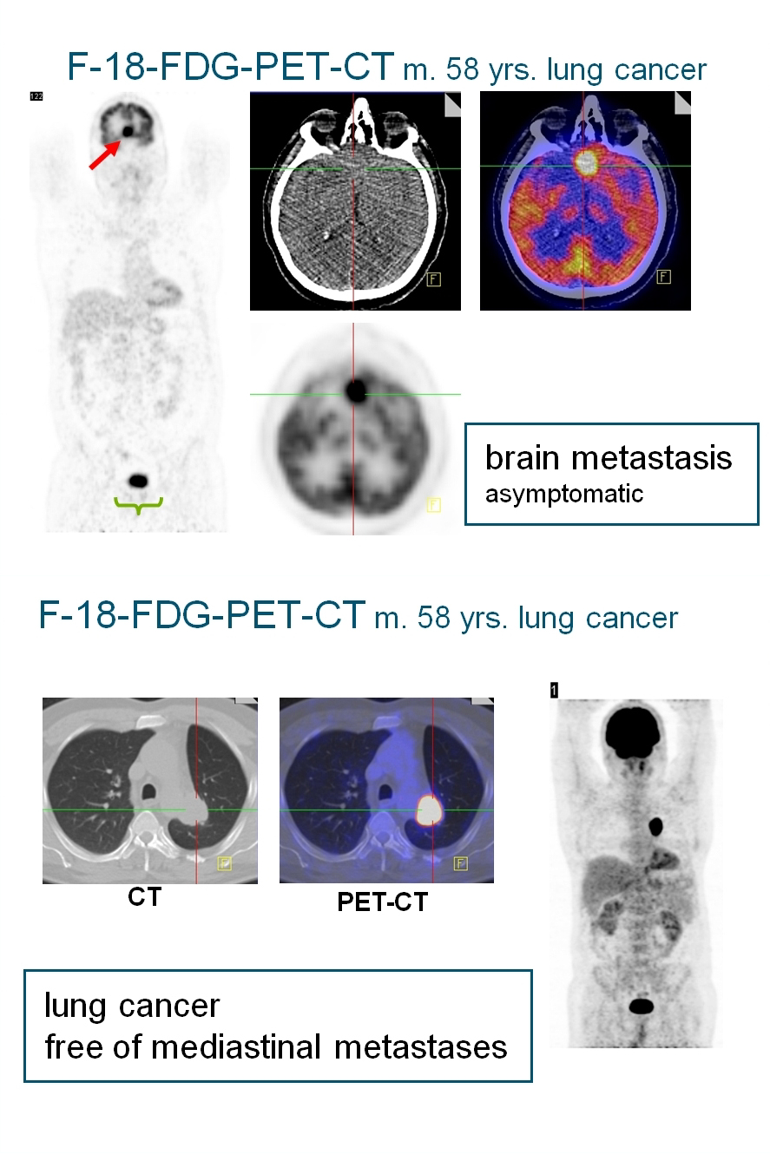
Macro Level physiology: Metabolism
Ropinski et al., 2009
Notes:
Interactive closeups

Slide 14
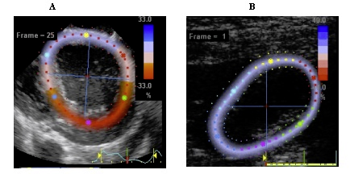
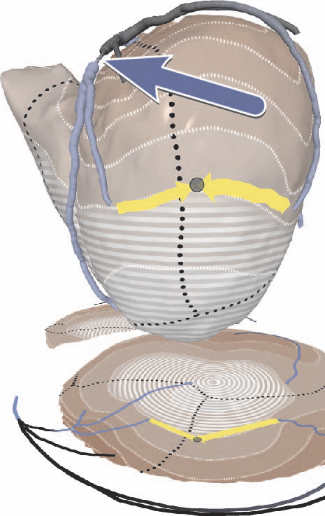
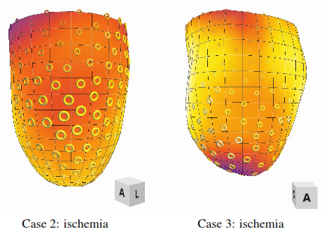
The Heart
Brekke et al 2008 (not published)
Termeer et al., 2008
Meyer-Spradow et al 2008
Notes:
Brekke strain
Ropinski multivariate mapping (spect, wall thickness

Slide 15
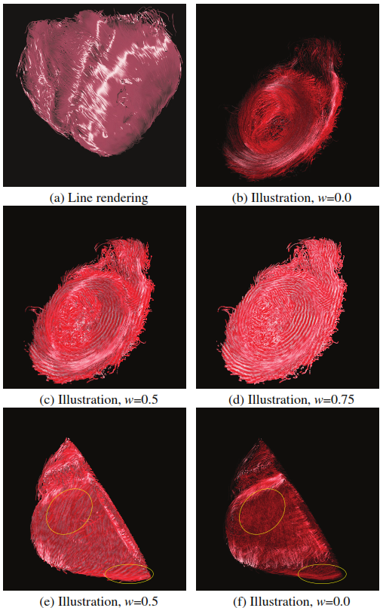
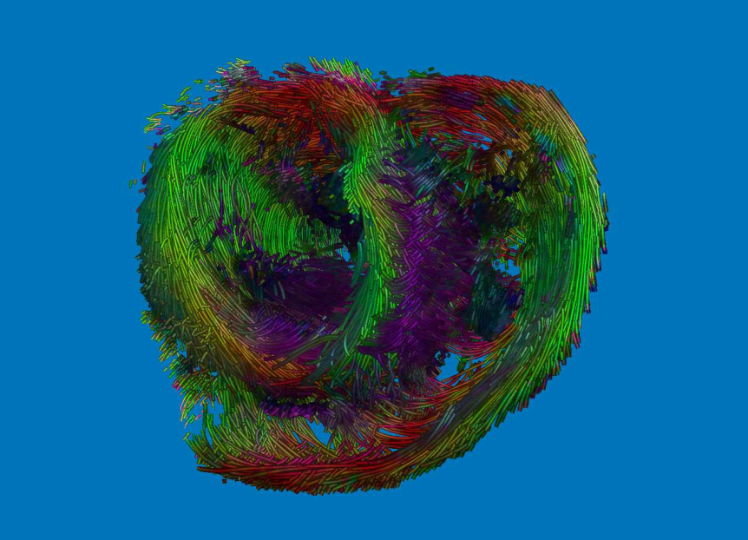
The Heart
Kondratieva et al., 2010
Chenet al., 2009
Toussaint et al., 2010
Notes:
Kondratieva particle tracing in gpu for tensor fields tracking
Toussaint et al improved curvilinear interpolation scheme for tensor fields reconstruction

Slide 16
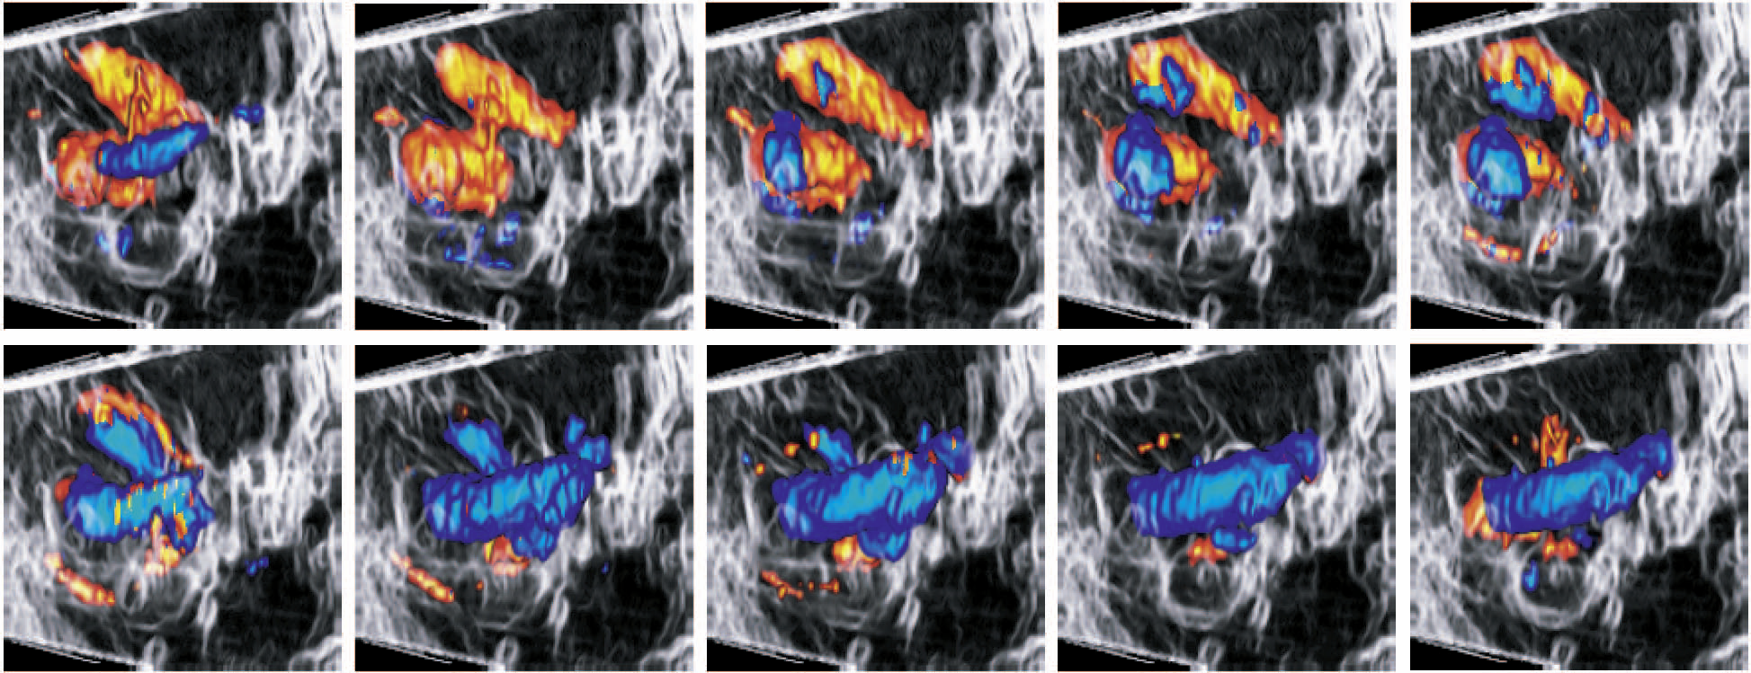
Circulation
Cell physiology
Membrane, Nerve and Muscle physiology
Petersch et al., 2007
Notes:
Combination of photorealistic and NPR rendering ffor bmode and color doppler. They combine siluette rendering for the context and a modified shading model for the focus in order to cope with the noisiness of US data

Slide 17
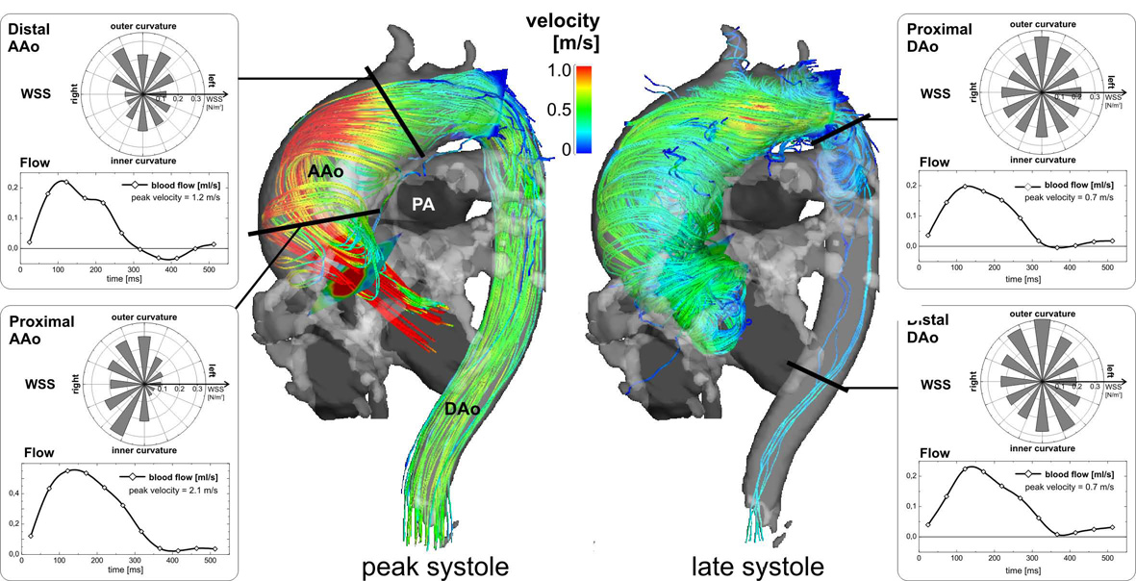
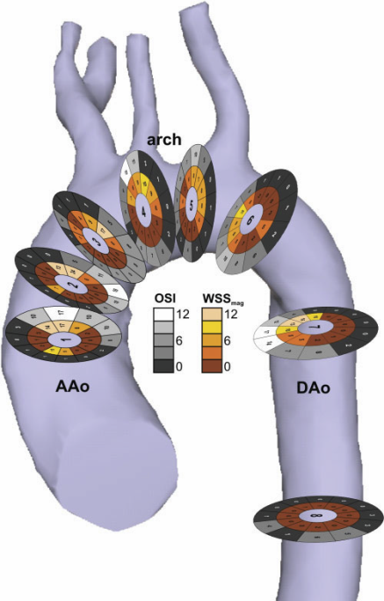
Circulation 2
Markl et al., 2011
Frydrycowycz et al., 2009
Gasteiger et al., 2011

Slide 18
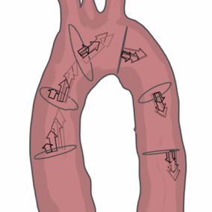
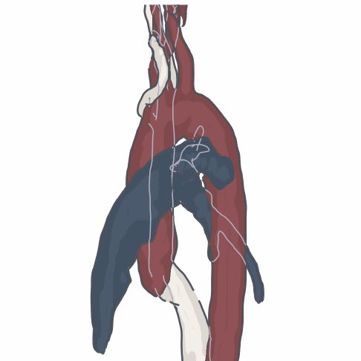
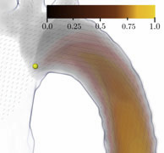
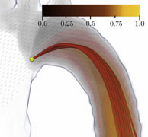
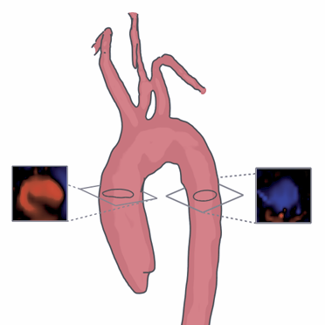
Circulation 3
Fridman et al., 2010
Van Pelt et al., 2010
Van Pelt et al., 2011

Slide 19
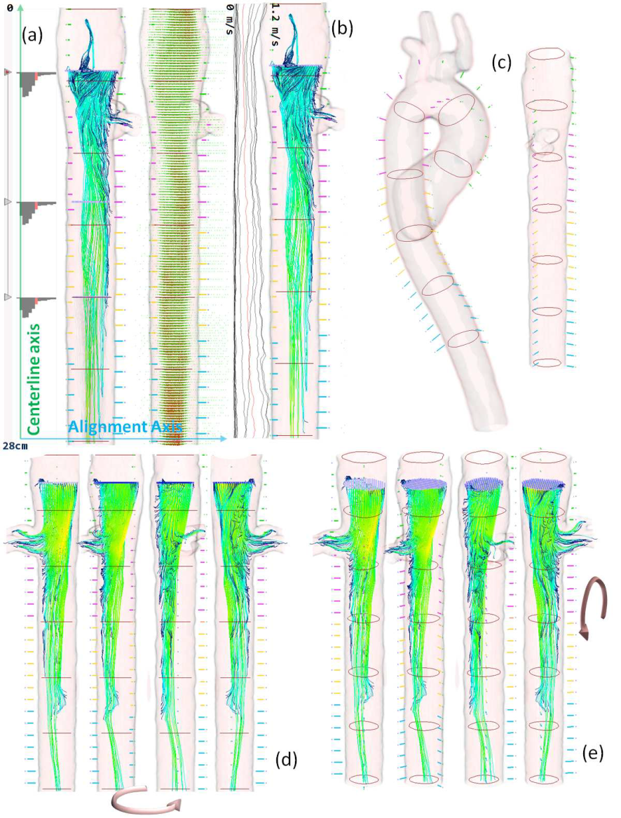
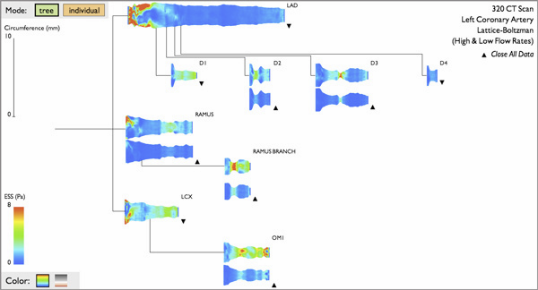
Circulation 4
Borkin et al., 2011
Angelelli and Hauser., 2011

Slide 20
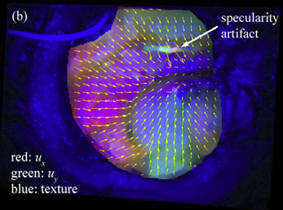
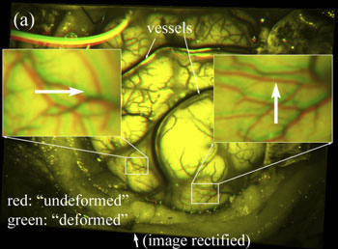
Circulation 5
Ji et al., 2011

Slide 21
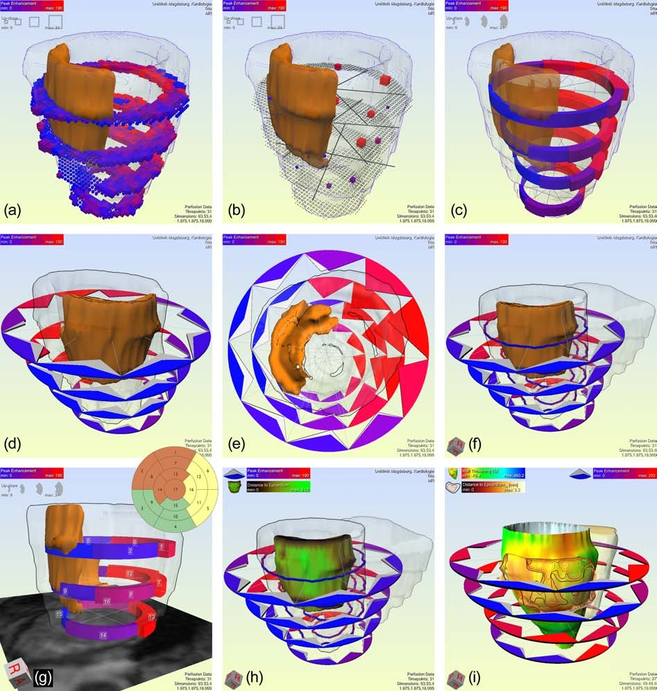
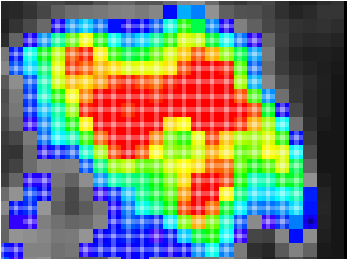
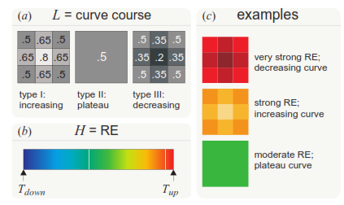
Micro Circulation
Glasser et al., 2009
Oeltze et al., 2008

Slide 22
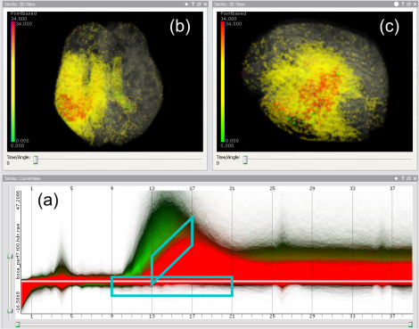
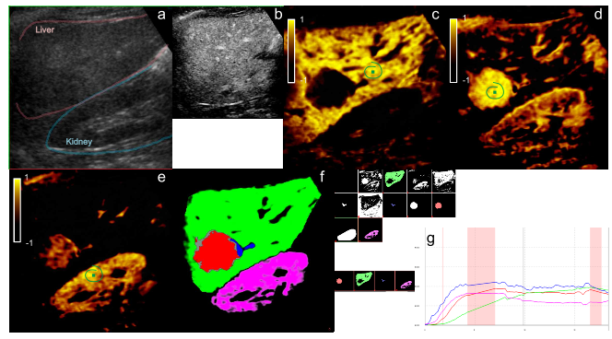
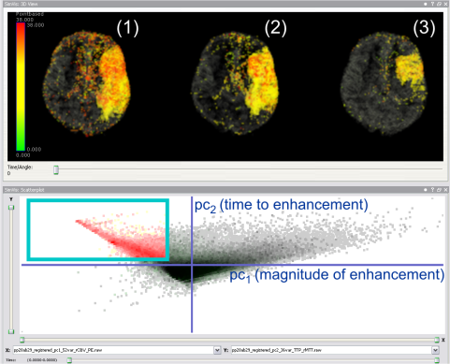
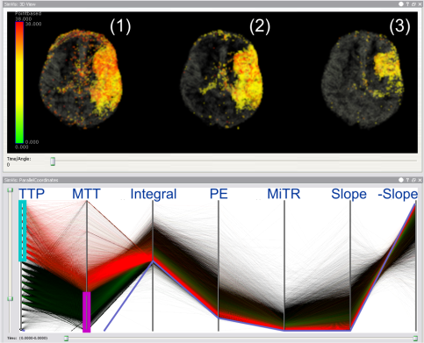
Micro Circulation
Angelelli et al., 2011
Oeltze et al., 2009

Slide 23
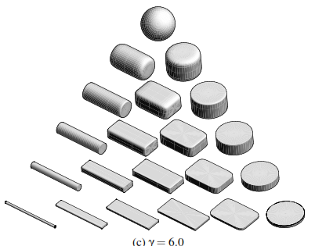
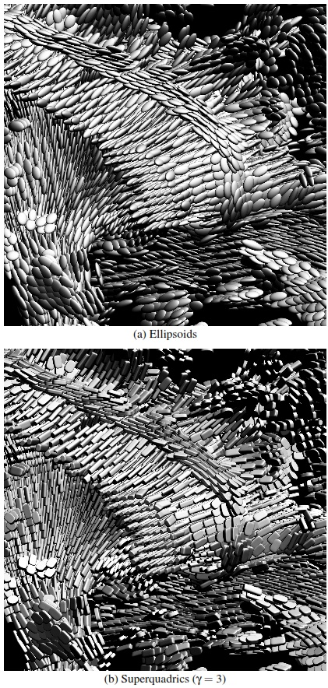
Micro Circulation
Wassermann et al., 2010
Shattucket al., 2008
Kindlmann et al., 2004
Demiralp et al., 2010

Slide 24
The Brain
Cell physiology
Membrane, Nerve and Muscle physiology
Anderson et al 2010
Zhang et al 2012

Slide 25
The Brain 2
Cell physiology
Membrane, Nerve and Muscle physiology
Eikeland , 2009
Dixoorn et al., 2010
Ystad et al., 2011

Slide 26
Respiration
Cell physiology
Membrane, Nerve and Muscle physiology
Lee et al 2010
Notes:
Cyclestack

Slide 27
Kinematic
Cell physiology
Membrane, Nerve and Muscle physiology
Krekel et al 2006
Krekel et al 2009

Slide 28
Kidneys
Cell physiology
Membrane, Nerve and Muscle physiology
Khalifa et al 2010

Slide 29
Gastric
Cell physiology
Membrane, Nerve and Muscle physiology
Gilja et al 1996

Slide 30
Sport
Cell physiology
Membrane, Nerve and Muscle physiology
Image courtesy of Polar Electro

Slide 31
Conclusion
Cell physiology
Membrane, Nerve and Muscle physiology

Slide 40
Data type
CELLULAR PHYSIOLOGY | NERVE, MUSCLE, MEMBRANE | METABOLISM | HEART PHYSIOLOGY | CIRCULATION
MICRO CIRCULATION | BODY FLUIDS and KIDNEYS | BLOOD CELLS and IMMUNITY | RESPIRATION | GASTRO-INTESTINAL
THE BRAIN | ENDOCRINOLOGY & REPRODUCTION | SPORT PHYSIOLOGY | AVIATION, SPACE, DEEP-SEA PHYS. | KINEMATIC?

Slide 41
The Heart: Data type
2D+T , 3D+T Ultrasound
4D Cardiac MR
4D PC-MR
4D CT
4D PET

Slide 42
Structure
Intro on Human physiology – what are we talking about
Acquiring information on physiological processes
Imaging
Modeling & Simulation (Peter Hunter, Inria as examples )
How populated is data acquisition for the different physio systems (what technology is used in each system)
Physio vis is not just vis, its more. Its visual computing. STAR in each unit of visual computing techs
List of vis strategies for the various type of data

